Slide 1

"Unveiling the Magic of Convolutional Neural Networks:
A Hands-On Journey into Image Recognition"
BACHELOR OF TECHNOLOGY in COMPUTER SCIENCE ENGINEERING
Submitted by
KARAN SINGH RAWAT
[RA2111003011002]
KUMAR ASHISH
[RA2111003011067]
Under the Guidance of
Dr. Sridhar S S
Assistant Professor
CTECH

Slide 2
Table of Contents
Section Description
Part I Introduction
Part II Understanding the Topic
Part III Analyze the Method
Part IV Design Interactive Learning
Part V Conclusion

Slide 3
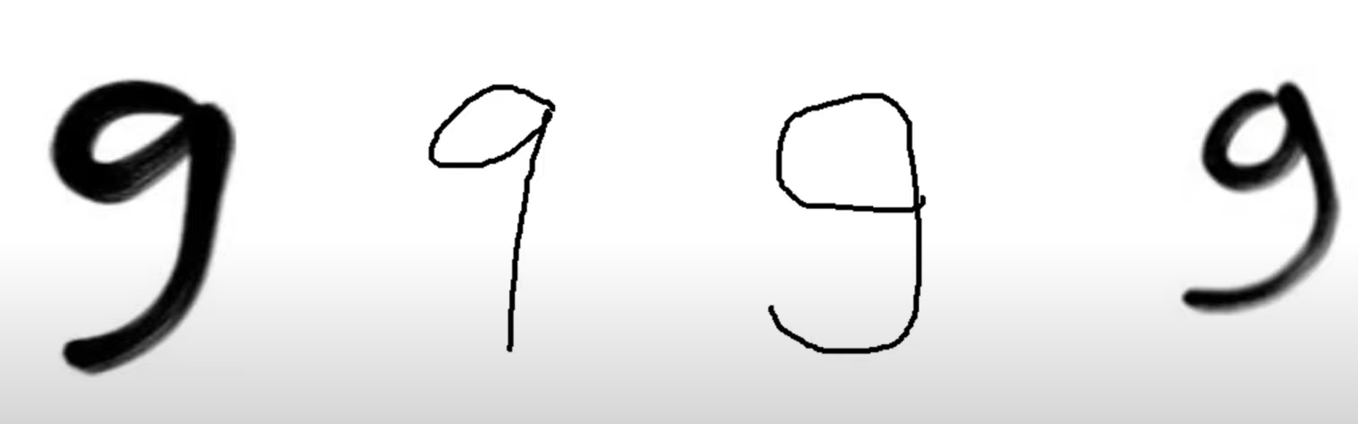
Introduction
Imagine you're teaching a friend how to recognize handwritten digits. You show them a picture of a messy "9" and explain its key features: the curved line at the top and the straight line coming down.
how does a computer do this? Traditionally, it would need very specific instructions to identify each pixel (tiny building block) in the image. This is like giving your friend a giant grid with instructions to check for a specific pattern of black and white squares everywhere.

Slide 4
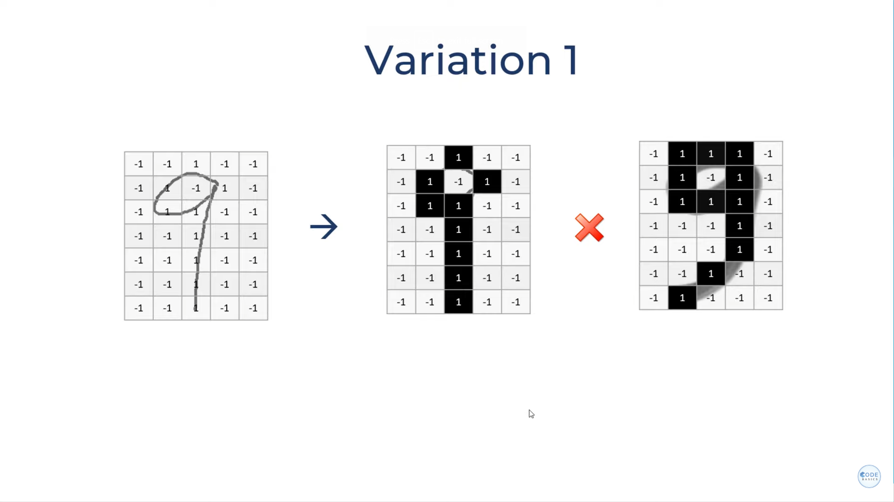
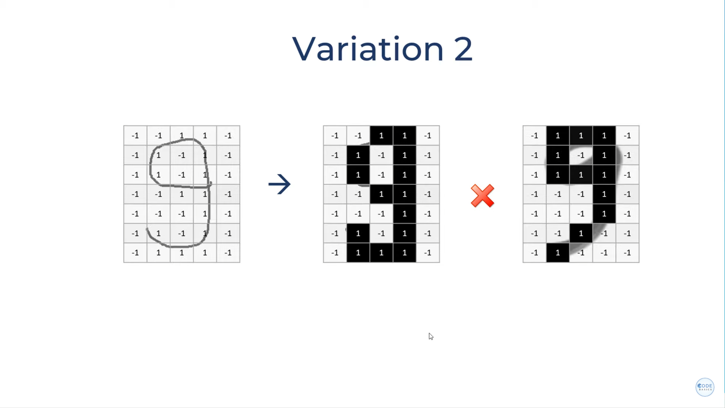
The problem? Handwritten digits can be messy! A slight slant or shift can throw off the whole grid system. The computer wouldn't recognize the "9" because the exact pattern it was looking for wouldn't be there.

Slide 5
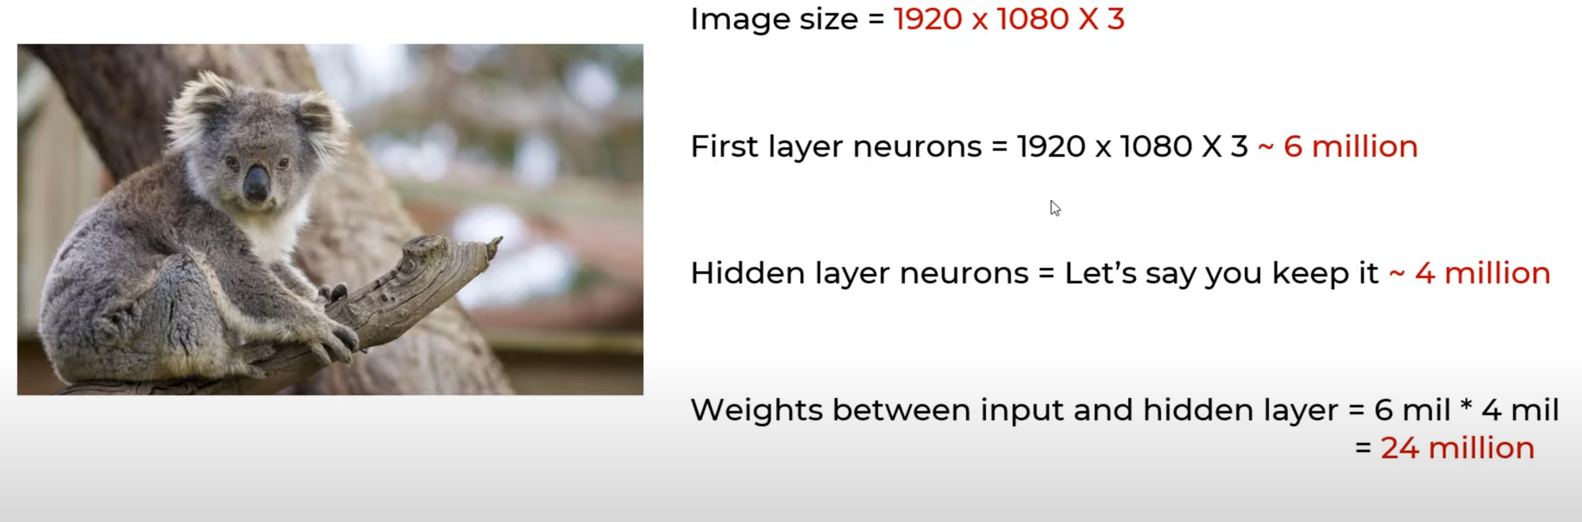
Here's where CNNs come in!
Instead of a giant grid, CNNs use small filters that slide across the image, looking for specific patterns like curves, lines, and corners.
If Computer use ANN model (Grid/block) for large Image it’s Not Suitable - That nearly 24 million hidden layers!

Slide 6
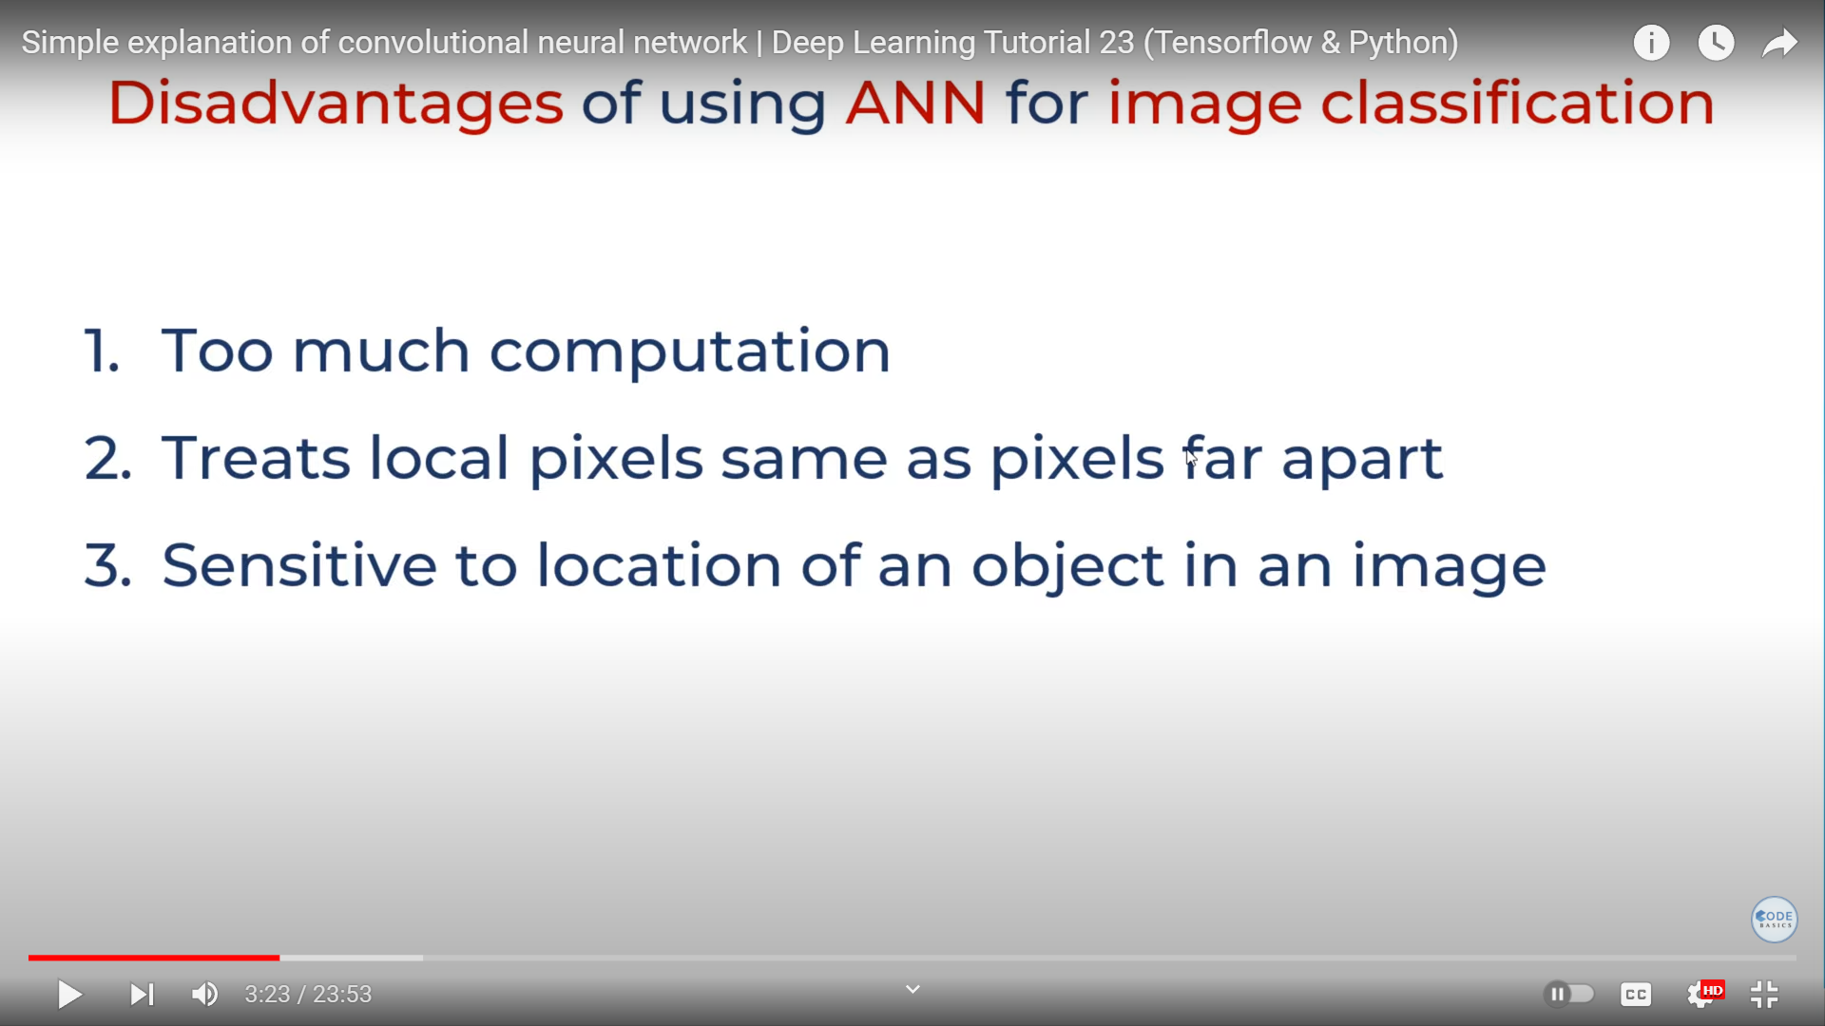
Part II : Understanding The Topic

Slide 7
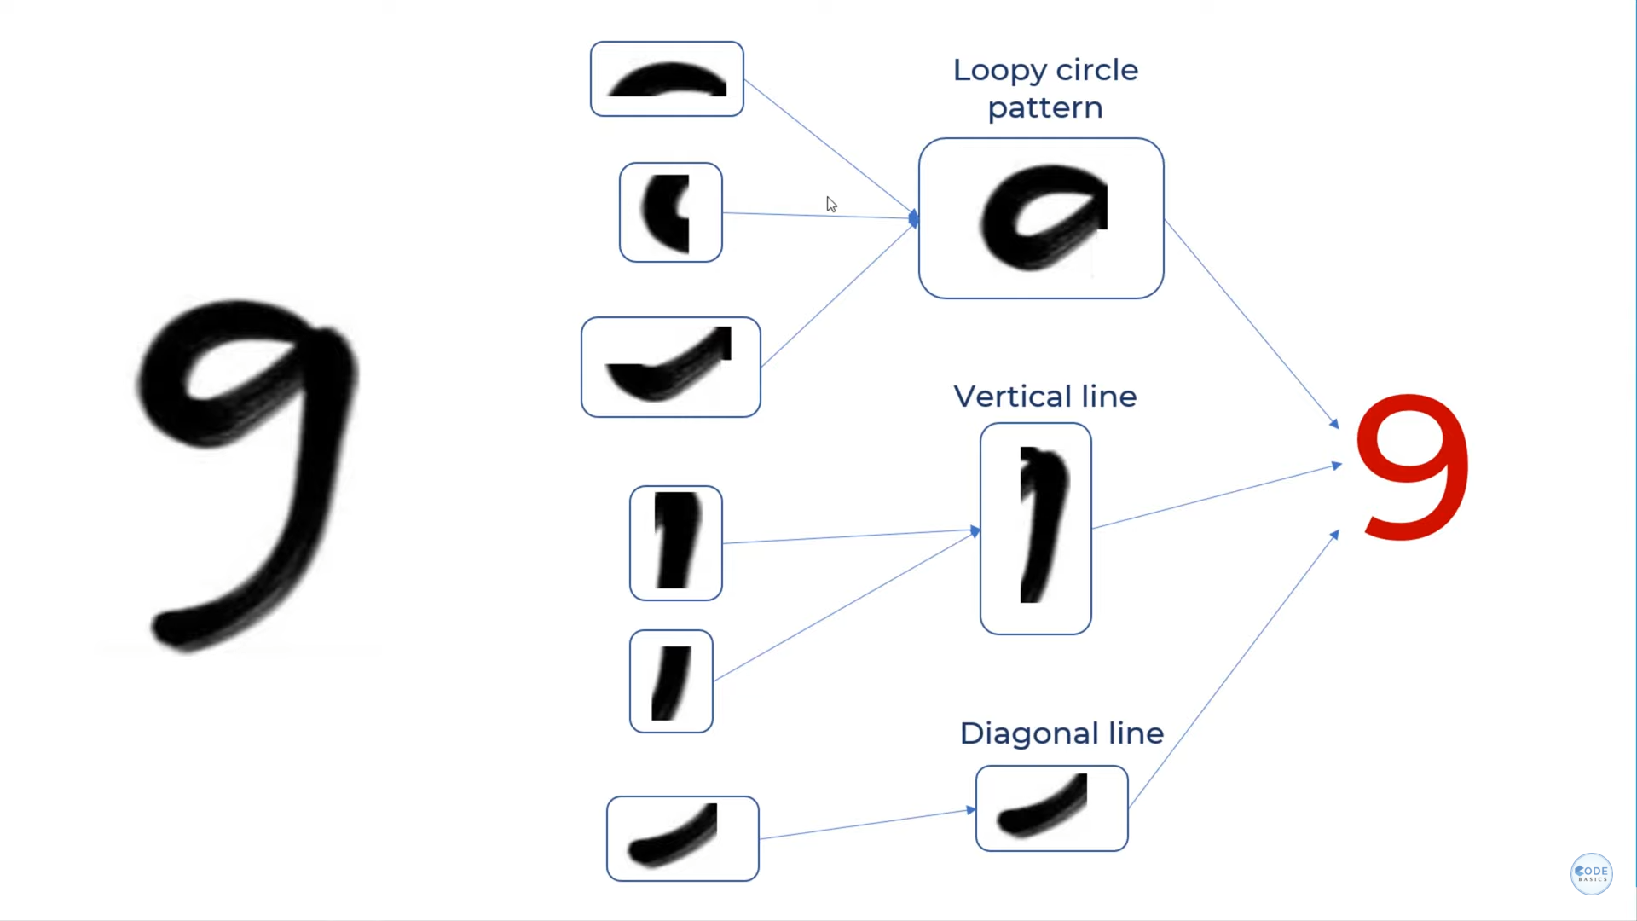
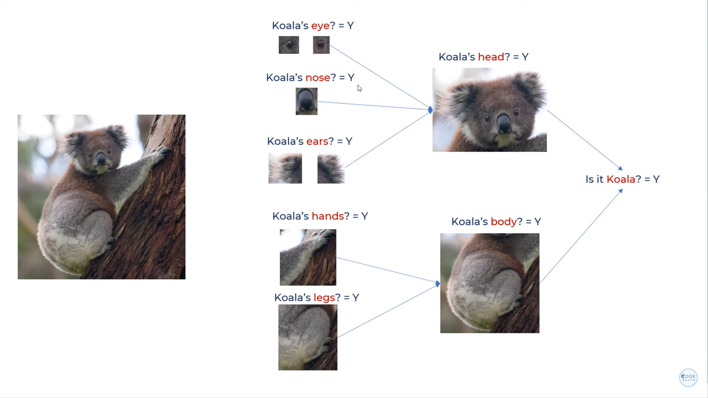
How CNN Work ?

Slide 8
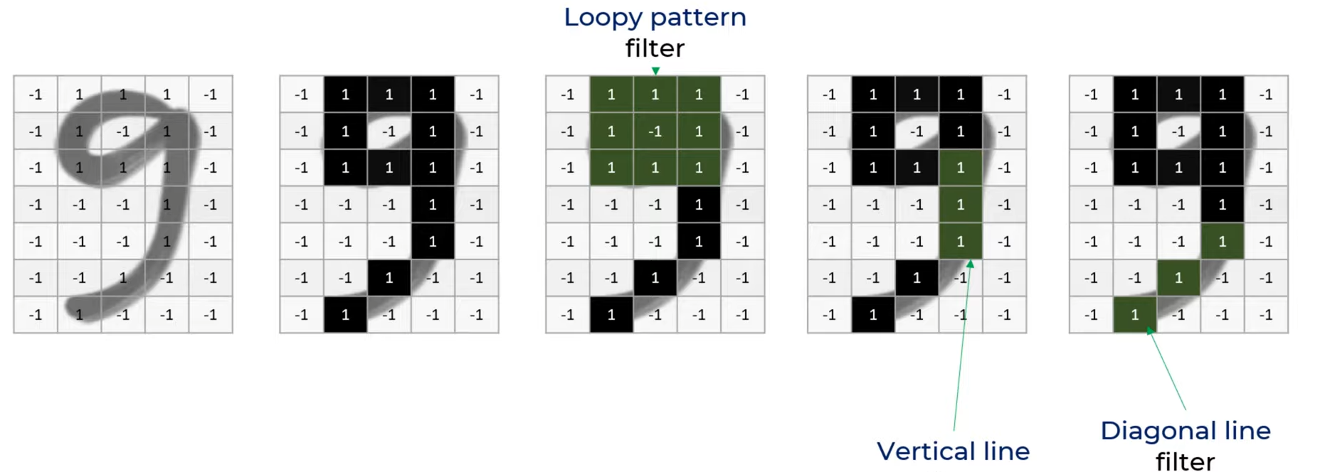
we've applied different filters (head, middle, tail) to create three separate feature maps for the digit nine.
We can repeat this process for other objects like a koala, using filters for eyes, nose, and ears, resulting in three distinct feature maps.
However, these feature maps are like individual clues – we need to combine them for a final decision.

Slide 9
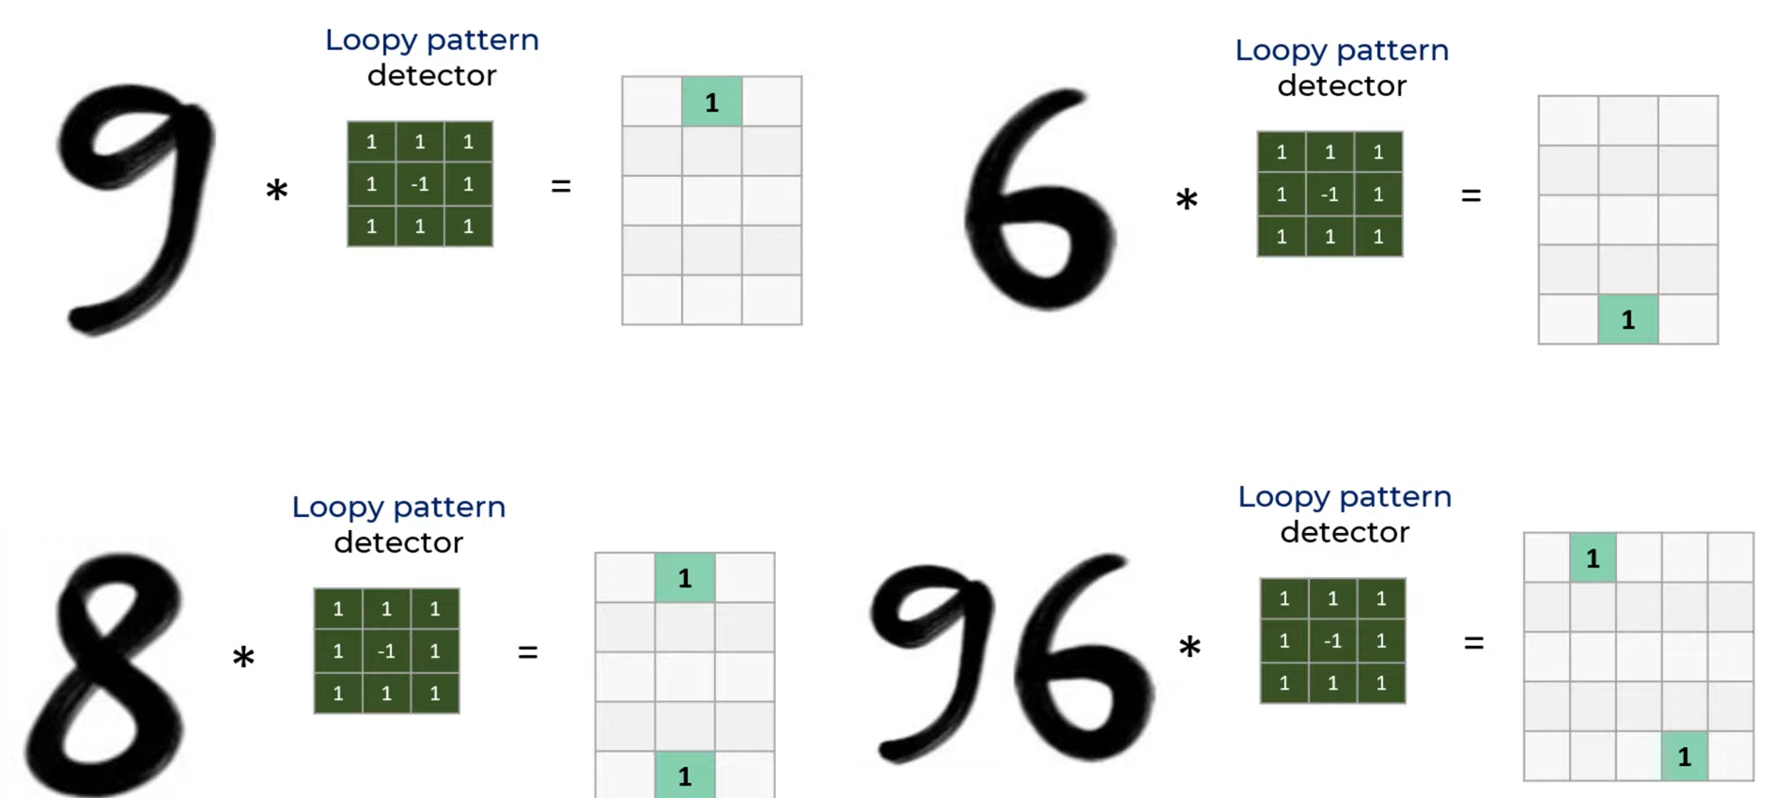
Filters are nothing the Feature’s Detectors
Applying Loopy Pattern Filter

Slide 10
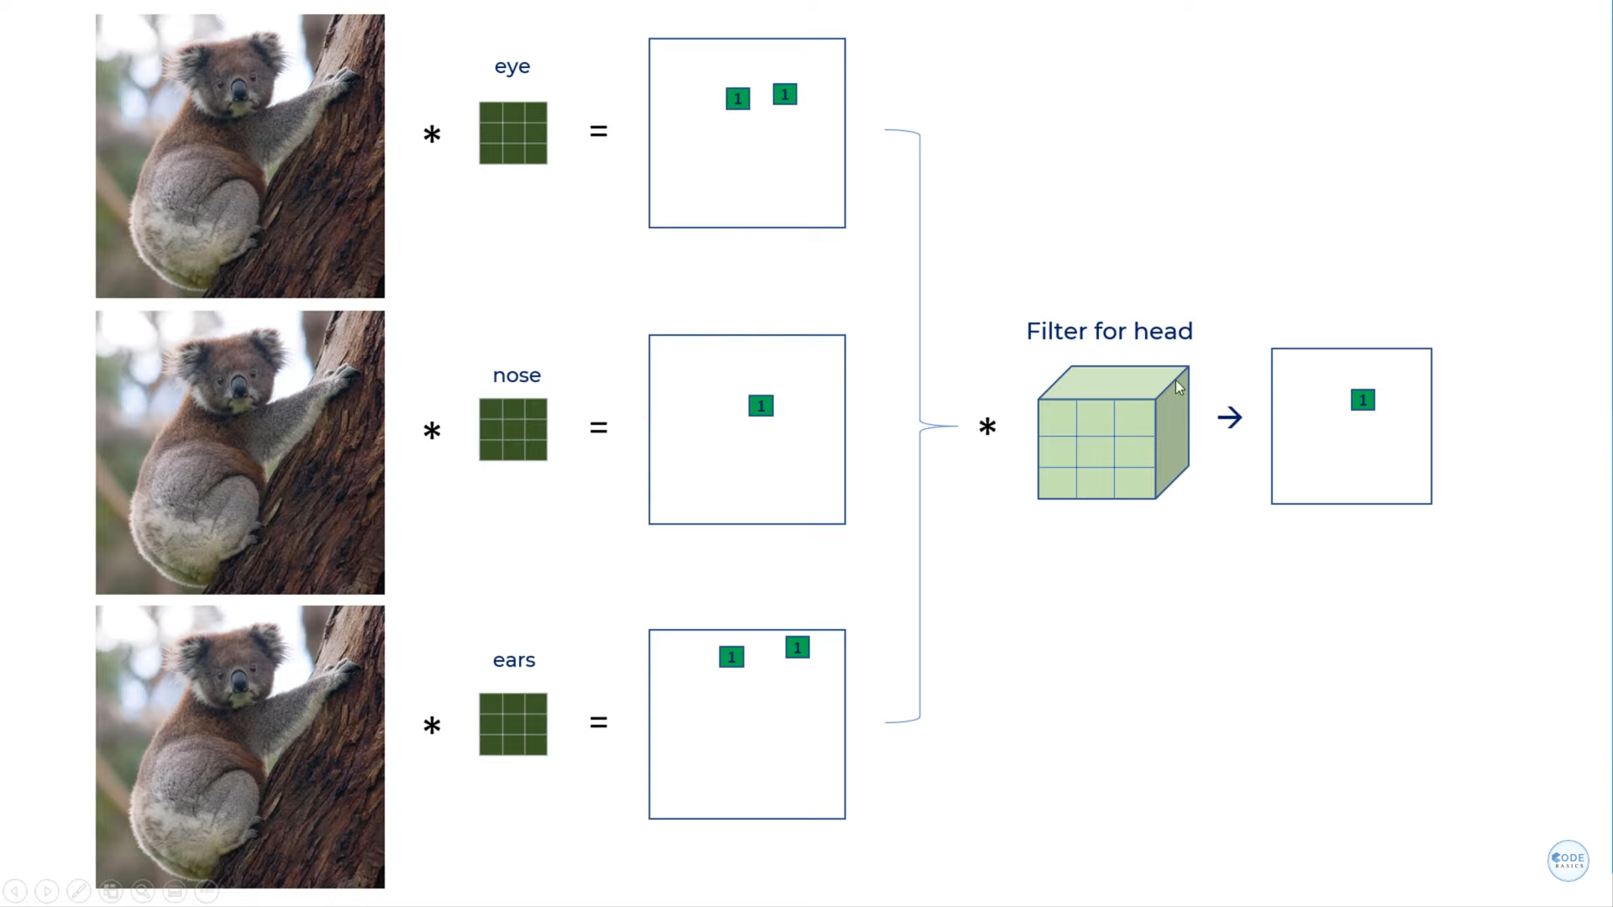
Let Understand This Concept With Complex Picture
Here 1 is optained after Applied
Loopy Filter.
Model Considering...
Eyes,Nose and Ears as round in
Head Part .

Slide 11
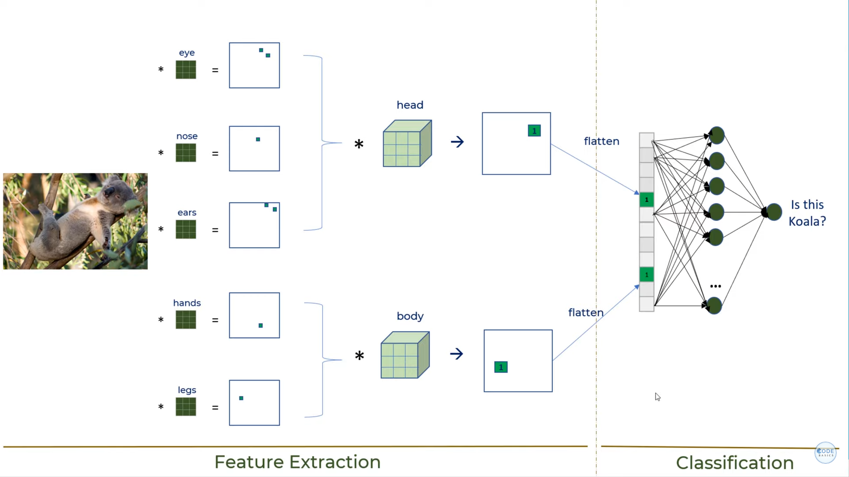
Topic III : Analyze The Method
Result

Slide 12
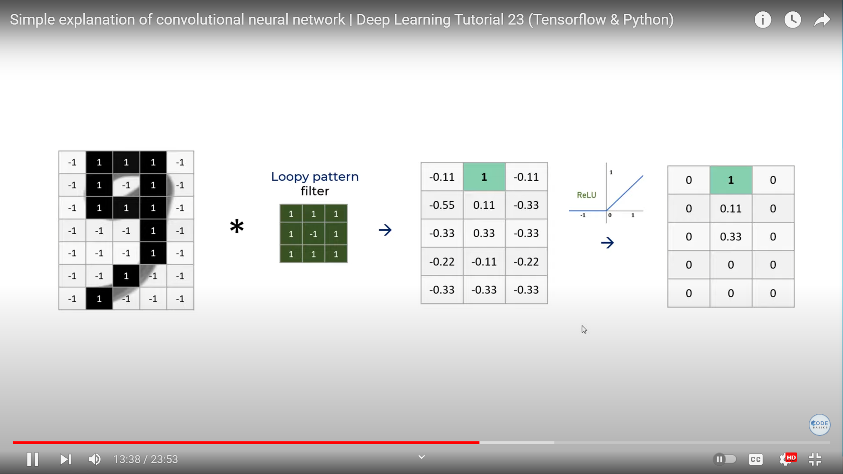
ReLu Function, helps With Making The Model NonLinear
Its convert the Negative values to : 0
while positive remain’s Same

Slide 13
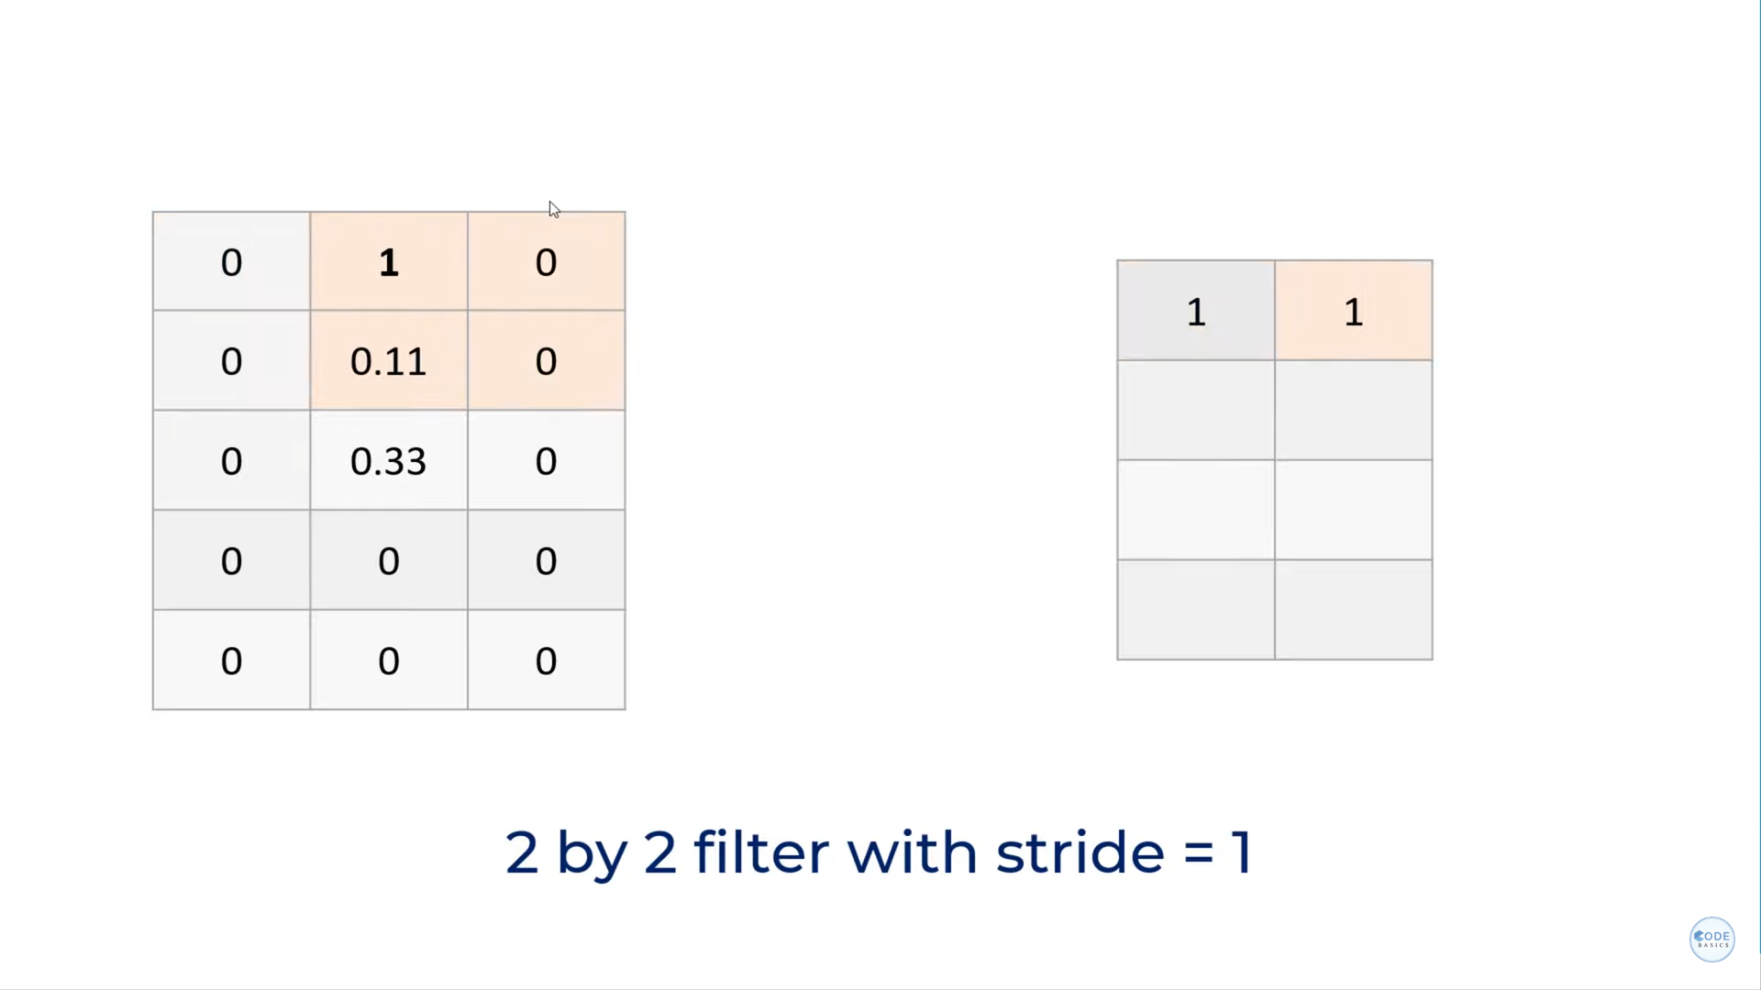
Pooling Layer is used to Reduce the Size
Here It Took Pair of 4 Points / pixcels
In first Four 1 is max
then Stride slide by 1
In next Four points 1 is
Max so it would be picked
Similary for whole Image it
applied and Decrease the Size of
image

Slide 14
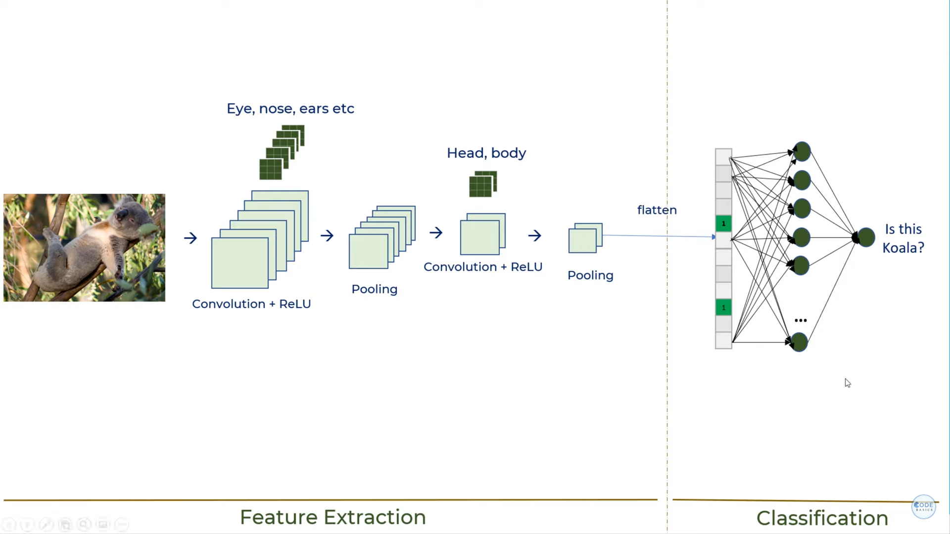
So This is How Complete Convolutional Neural Network Look LIke...
Feature Extraction + Classification

Slide 15
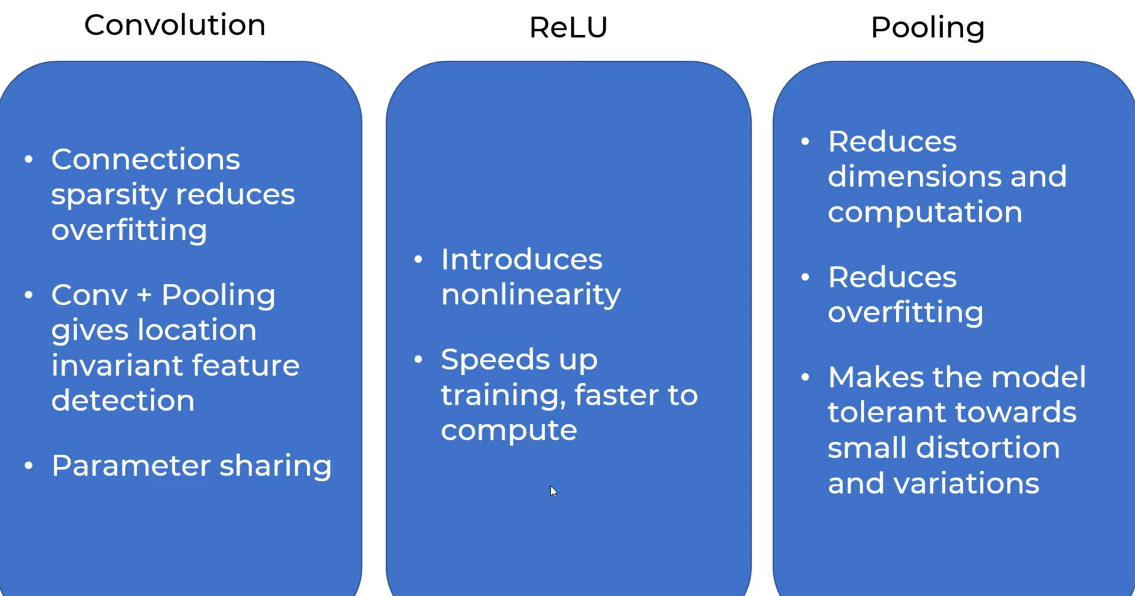

Slide 16
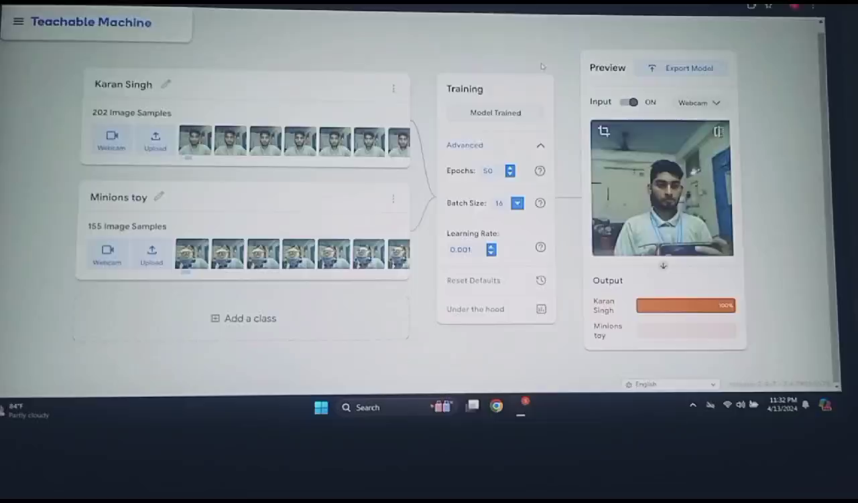
Topic IV : Intereactive Learning Showcase
CNN Model after Trained with few Samples Able to Differtiate between me and toys.
Capable enough to detect
even moving Object with
Different Angle’s.
Click on the Video to Play →

Slide 17
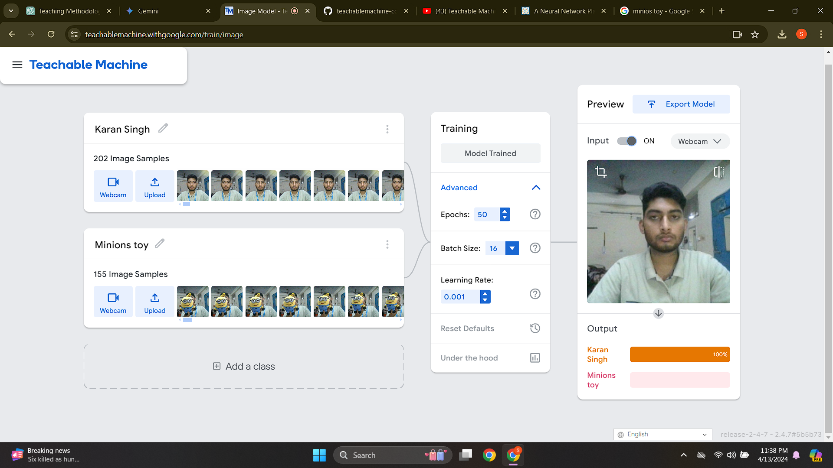
202 sample Image of Human Being , 155 picture of Toys , Epochs -50 , Where as Learning Rate is -0.001

Slide 18
Part V : Conclusion
In summary, convolutional neural networks (CNNs) offer a groundbreaking approach to image recognition tasks by efficiently extracting features, reducing computational complexity, and achieving robust performance across diverse datasets. Their ability to handle variations in image presentation while mimicking human visual recognition capabilities makes them invaluable tools in the field of artificial intelligence.
Regular computers struggle with image variations. Convolutional Neural Networks (CNNs) solve this by automatically learning tiny features (eyes, curves) from images. This allows CNNs to recognize objects despite variations, but requires a lot of computation. That's why CNNs are powerful but complex!.

Slide 19
References
GCR -SRM PPT’s
S.N.Sivanandan, S.N.Deepa, Principles of Soft Computing, 3 edition , Wiley Publications
Visualizing CNNs and their Filters [Blog] (Distill.pub): https://distill.pub/ Deeplearning.ai - Convolutional Neural Networks [Website]: https://www.coursera.org/learn/convolutional-neural-networks https://cs231n.stanford.edu/2021/slides/2021/lecture_5.pdf https://youtu.be/zfiSAzpy9NM?si=oDumUzPityniQWg-

Slide 20
from keras.models import load_model # TensorFlow is required for Keras to work
from PIL import Image, ImageOps # Install pillow instead of PIL
import numpy as np
# Disable scientific notation for clarity
np.set_printoptions(suppress=True)
# Load the model
model = load_model("keras_Model.h5", compile=False)
# Load the labels
class_names = open("labels.txt", "r").readlines()
# Create the array of the right shape to feed into the keras model
# The 'length' or number of images you can put into the array is
# determined by the first position in the shape tuple, in this case 1
data = np.ndarray(shape=(1, 224, 224, 3), dtype=np.float32)
# Replace this with the path to your image
image = Image.open("<IMAGE_PATH>").convert("RGB")
# resizing the image to be at least 224x224 and then cropping from the center
size = (224, 224)
image = ImageOps.fit(image, size, Image.Resampling.LANCZOS)
# turn the image into a numpy array
image_array = np.asarray(image)
# Normalize the image
normalized_image_array = (image_array.astype(np.float32) / 127.5) - 1
# Load the image into the array
data[0] = normalized_image_array
# Predicts the model
prediction = model.predict(data)
index = np.argmax(prediction)
class_name = class_names[index]
confidence_score = prediction[0][index]
# Print prediction and confidence score
print("Class:", class_name[2:], end="")
print("Confidence Score:", confidence_score)
Source Code

Slide 21
ZIP File , Source Code and Presentation Uploded on GCR
and Github.
Github link - https://github.com/kk8873
Thankyou

